Slide 1

Best Practices We Follow to Retain Our Customers
Presented by: Captive Power – Hyderabad

Slide 2


About Us
Captive Power : Legacy Built Over 5 Decades
🛠 Founded: 1990
👤 Founder: Mr. M.N. Sastry
Our Journey with Kirloskar
1971–72 | Kirloskar Filters
1978–81 | KOEL Sales & Service, Secunderabad – Service Engineer
1981–90 | KOEL Dealer “Spares & Supplies” – Group Head

Slide 3
Core Team at Captive Power
M.N. Sastry & Naveen Reddy – Partners
Mr. Naveen Reddy – Partner & Business Head
Mr. Hanumatha Rao – Sr. Sales Engineer
Mr. Y. Arjun & Team – Sr. Service Engineer (HHP & Ultra HHP)
Mr. R. Arjun Rao & Team – Service Engineer (LHP & MHP)
Mr. Ravinder & Team – Sr. Electrical Engineer (AMF Panels)
Ms. Shruthilaya – Pulse Engineer & Office Assistant

Slide 4
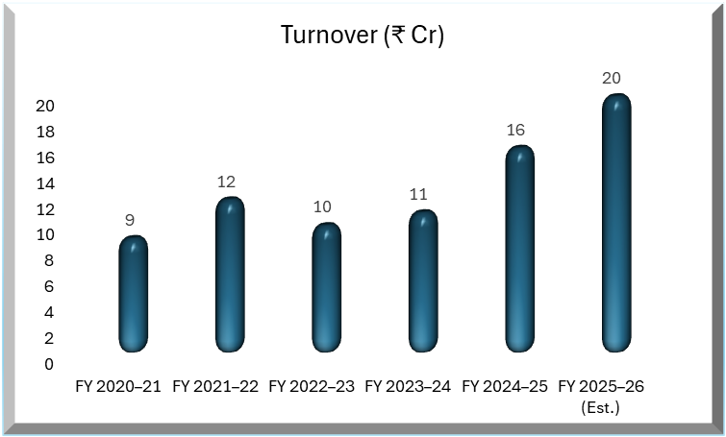
Turnover Performance &
FY26 Projection
Our Kam Customers contribute 40% to Over All T/O

Slide 5



Our Philosophy
Customers Are Like Coconut Trees
But once grown, they give us regular returns – a steady business crop.
Long-term success depends on how well we take care of them.
They need nurturing, patience, and care.

Slide 6
Roles
Before & After the Order
KOEL & GOEM play an essential role in
Pricing support and timely delivery of quality products.
Once the order is received, we believe
It becomes the full responsibility of the KGD/KSD to retain and grow the customer relationship.

Slide 7
On-Site Supervision
First Impressions Matter
We ensure the customer’s first experience is smooth and professional
We depute our representative/engineer to the site for supervision of DG unloading, anywhere in India.
We record a video from the moment the DG arrives on the truck to unloading completion – ensuring transparency.

Slide 8
Tools for Safety & Readiness
Real-Time Communication
We carry our own belts and hooks, like a “cricket kit,” especially for DV Series (MHP & HHP) sets.
We have a dedicated WhatsApp group of 11 key team members.
This acts as a safety backup in case the hydra operator's belts are of poor quality.
Live updates, advice, and coordination happen in real time
This helps us respond quickly and maintain control across all sites
Shows our readiness and commitment to safe handling

Slide 9
Documentation
Organized & Trustworthy
We take customer signatures on a proper Handing Over Letter
Includes invoice, test certificates, keys, and all related documents
We keep site-wise records of all KAM customers
Enables quick access to documents when needed – customers appreciate this reliability

Slide 10

Prompt Response Culture
We closely follow up with KOEL/KSD to resolve:
Installation, warranty, and post-warranty issues.
We never delay responses to customer calls – from Head Office or sites.
We know that fast response = stronger trust.

Slide 11
We address every person at customer end as “Sir / Sirji” – regardless of designation.
Professional Respect & Relationship Building
We give special attention to site-level engineers, because:
Their feedback can influence H.O decisions.
We aim to win hearts on the ground to win business from the top.

Slide 12

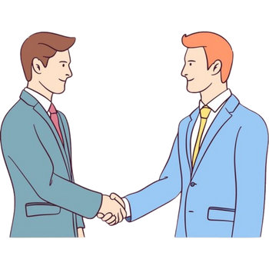
Our Mission
Make Customers Addicted to Our Service
We believe in creating a “service addiction” among customers.
When site teams trust us, they recommend our brand to their Head Office.
That’s how we ensure customer retention, repeat business, and brand loyalty.

Slide 13


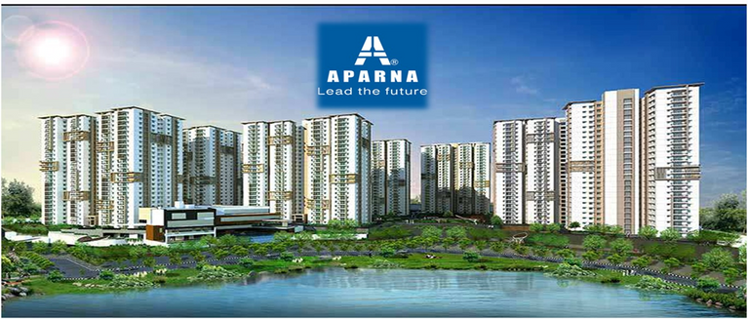





CUSTOMERS

Slide 14
THANK YOU

